Slide 1
Neural Architecture Search
Bostan Khan
PhD Candidate, Mälardalen University
Automating the Art of AI Model Design

Slide 2
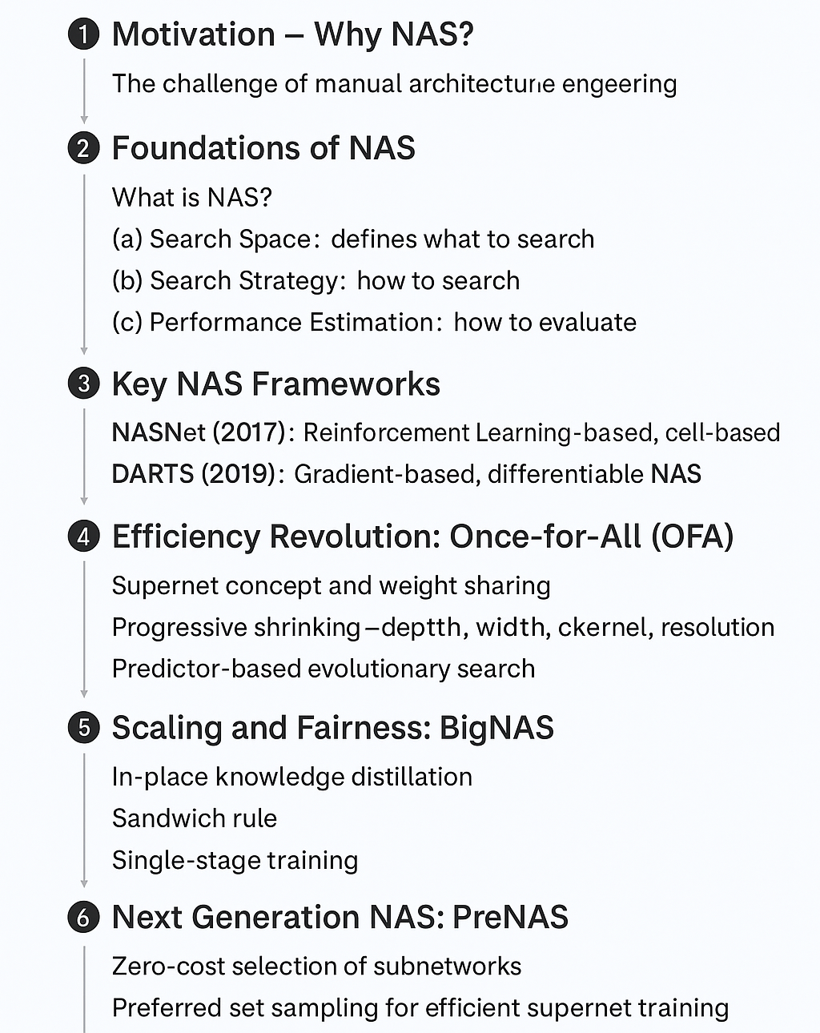
Neural Architecture Search Seminar Roadmap

Slide 3
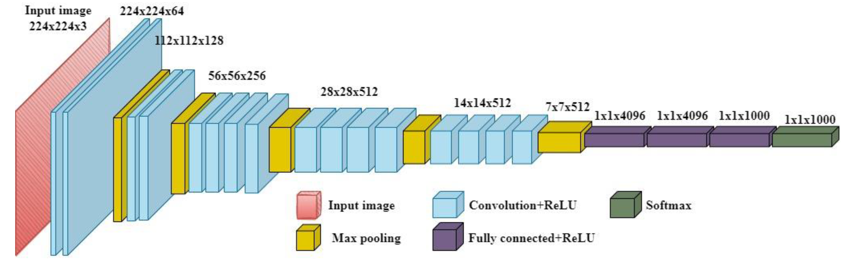
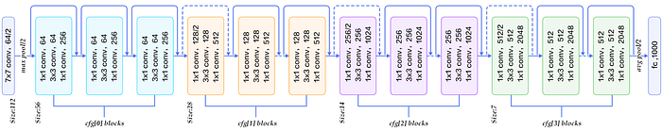
The Challenge of “Architecture Engineering”
We know DL models are powerful... but how are they designed?
The Manual Process:
Traditionally, architectures are designed by human experts.
This is a slow, expensive process that relies on "intuition" and trial-and-error.
VGG-19 CNN
ResNet CNN
https://www.mdpi.com/2624-7402/4/4/56
https://blog.devgenius.io/resnet50-6b42934db431

Slide 4

The Challenge of “Architecture Engineering”
In a neural network:
How do you decide how many layers?
Why a 3 x 3 convolution and not a 5 x 5?
How many channels/filters?
What is the ideal input resolution?
The Result
The performance of our models is limited by human imagination and time

Slide 5
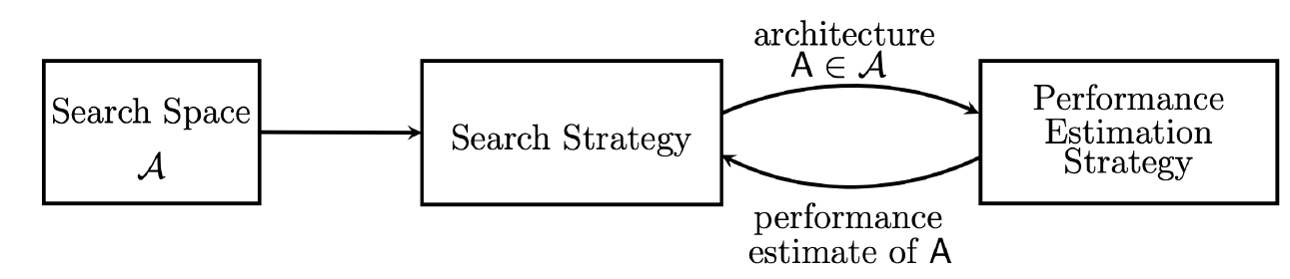
The Solution: Neural Architecture Search (NAS)
It is the art of using AI itself to build better AI models
Formally,
NAS automates the process of designing a neural network.
It's a method that searches through a space of possible architectures to find one that optimizes a specific goal (e.g., highest accuracy).
Source: MIT 6.5940 - TinyML and Efficient Deep Learning Computing

Slide 6
The 3 Components of NAS (1/3): Search Space
Determining the building blocks for our models

Slide 7
The 3 Components of NAS (1/3): Search Space
The “box of LEGO bricks” that the AI architect is allowed to use.
What does it define?
Operations: What kind of layers are allowed? (e.g., 3x3 conv, 5x5 conv, Max Pooling, Skip Connection, etc.)
Connections: How can these layers be connected?
The Obvious Approach:
Let's try to find the blueprint for the entire network! (This is called a Global Search Space).
The CATCH (A “Combinatorial Explosion”):
The number of possible architectures in a global search space is astronomical (e.g., 10⁶⁰ possibilities or more!).

Slide 8
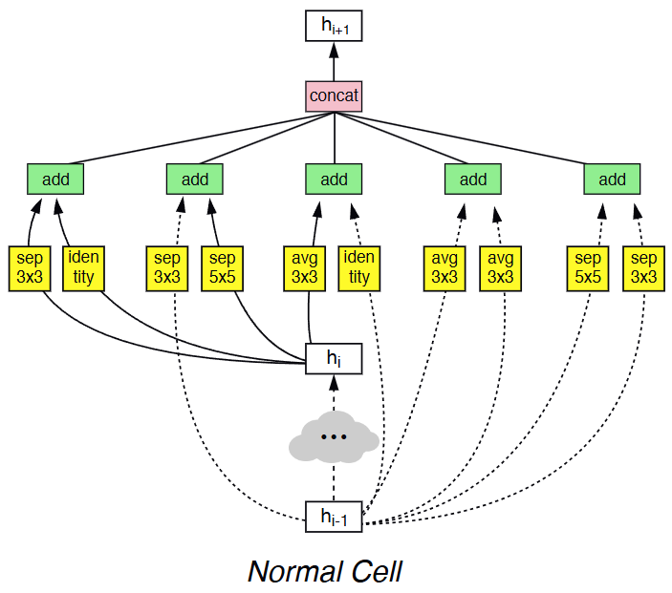
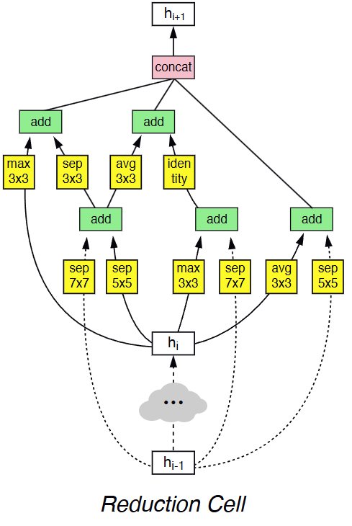
(1/3) Search Space : “Cell-Based”
NASNet, 2017:
Instead of designing an entire skyscraper, let's design one perfect LEGO brick (a 'Cell'), and then just stack that brick.
How it works:
The search algorithm only focuses on finding the best small "cell" architecture.
The final, large network is built by repeating this one cell.
This is a much smaller and more manageable search problem!
Zoph, Barret, et al. "Learning transferable architectures for scalable image recognition." Proceedings of the IEEE conference on computer vision and pattern recognition. 2018.

Slide 9
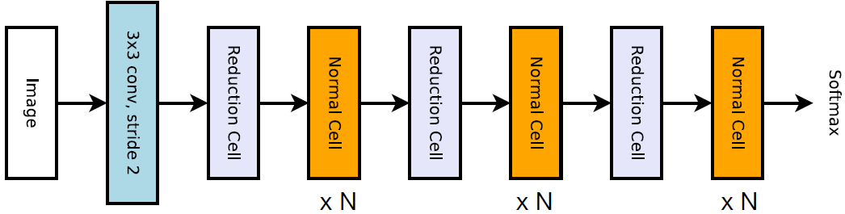
(1/3) Search Space : “Cell-Based”
Zoph, Barret, et al. "Learning transferable architectures for scalable image recognition." Proceedings of the IEEE conference on computer vision and pattern recognition. 2018.
Source: MIT 6.5940 - TinyML and Efficient Deep Learning Computing

Slide 10
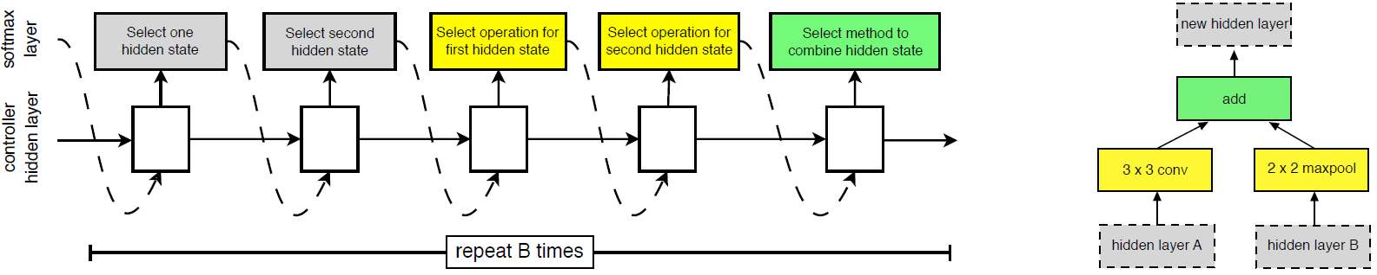
(1/3) Search Space : “Cell-Based”
Left: An RNN controller generates the candidate cells by:
finding two inputs
selecting two input transformation operations (e.g. convolution / pooling / identity)
selecting the method to combine the results.
Right: A cell generated after one step.
The RNN is trained using Reinforcement Learning.
Zoph, Barret, et al. "Learning transferable architectures for scalable image recognition." Proceedings of the IEEE conference on computer vision and pattern recognition. 2018.
Source: MIT 6.5940 - TinyML and Efficient Deep Learning Computing

Slide 11
(1/3) Search Space : “Cell-Based”
Question: Assuming that we have two candidate inputs, M candidate operations to transform the inputs and N potential operations to combine hidden states, what is the size of the search space in NASNet if we have B layers?
Answer: (2 × 2 × M × M × N)^{B} = 4^{B}M^{2B}N^{B}
Assume M=5, N=2, B=5, we have 3.2 × 10¹¹ candidates in the design space.
Zoph, Barret, et al. "Learning transferable architectures for scalable image recognition." Proceedings of the IEEE conference on computer vision and pattern recognition. 2018.
Source: MIT 6.5940 - TinyML and Efficient Deep Learning Computing

Slide 12
(1/3) Search Space : “Cell-Based”
The Drawback: Prohibitive Cost! 💸
The original NAS paper trained ~12,800 models on CIFAR-10.
This took 22,400 GPU-hours (almost 2.5 GPU-years!).
Scaling this to large datasets like ImageNet is often computationally infeasible
Zoph, Barret, et al. "Learning transferable architectures for scalable image recognition." Proceedings of the IEEE conference on computer vision and pattern recognition. 2018.
Source: MIT 6.5940 - TinyML and Efficient Deep Learning Computing

Slide 13
A Different Approach: The “Supernet” Space
The 3 Components (1/3): Search Space (Cont.)

Slide 14
(1/3) Search Space : The “Supernet” Space
The Problem with Cell-Based Search:
Even with cells, the NASNet loop (Sample -> Train -> Get Reward) is extremely slow.
You still have to train thousands of individual "child" networks from scratch, which is the bottleneck
The "Supernet" / "One-Shot" Idea:
What if we only train one single, massive network that contains all other 'sub-networks' within it
This giant network is going to be called the Supernet.

Slide 15
(1/3) Search Space : The “Supernet” Space
Core Idea: Decoupling Training from Search
Step 1 (Train): Train this giant Supernet once. The trick is to train all possible “paths” (sub-networks) at the same time by sharing weights. (This is the slow part, but you only do it once).
Step 2 (Search): After the Supernet is trained, you can get the performance of any "sub-network" (e.g., a smaller path) instantly without any more training.

Slide 16
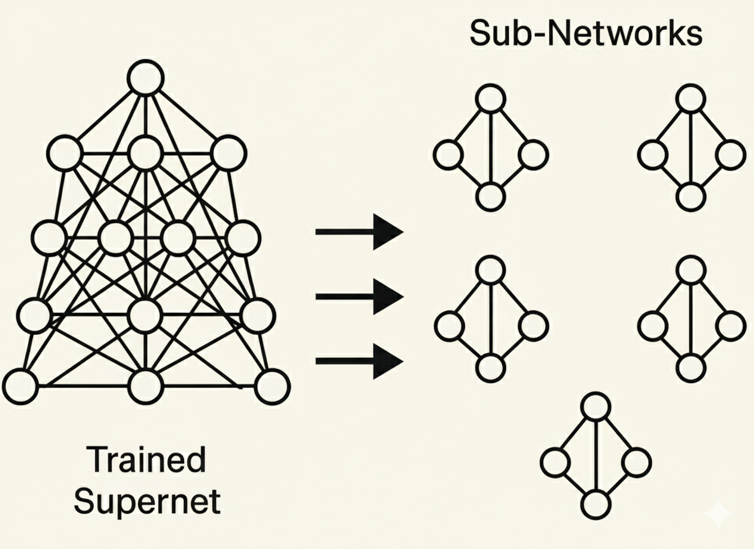
(1/3) Search Space : The “Supernet” Space
Core Idea: Decoupling Training from Search

Slide 17
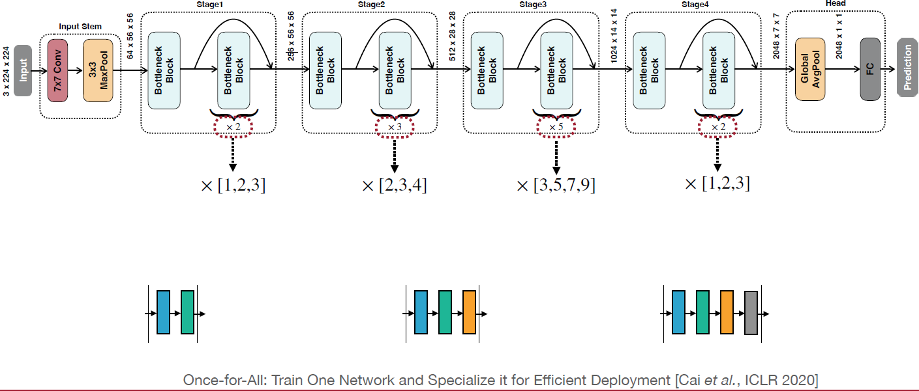
(1/3) Search Space : The “Supernet” Space
Network-level search space: depth dimension
Source: MIT 6.5940 - TinyML and Efficient Deep Learning Computing

Slide 18
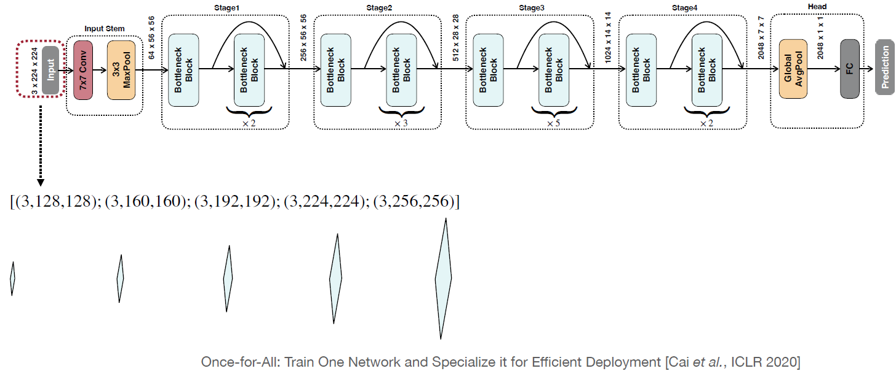
(1/3) Search Space : The “Supernet” Space
Network-level search space: resolution dimension
Source: MIT 6.5940 - TinyML and Efficient Deep Learning Computing

Slide 19
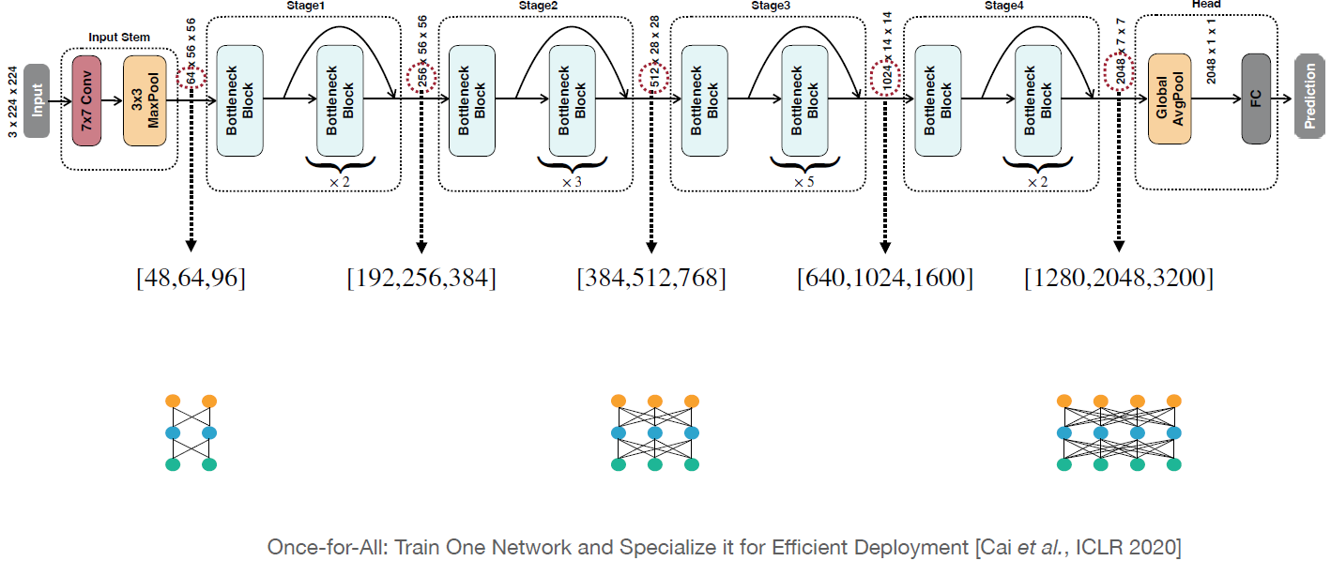
(1/3) Search Space : The “Supernet” Space
Network-level search space: width dimension
Source: MIT 6.5940 - TinyML and Efficient Deep Learning Computing

Slide 20
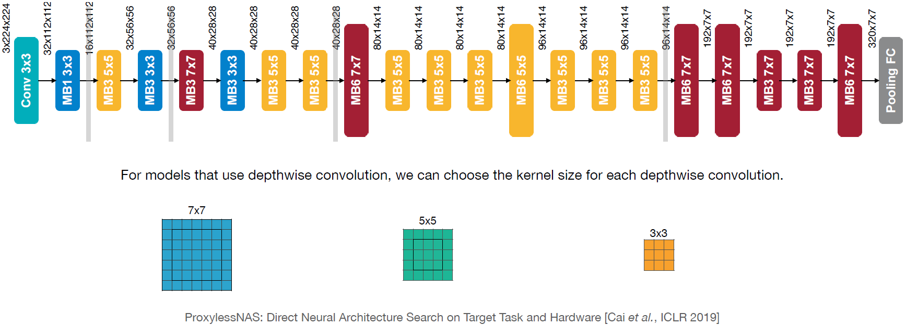
(1/3) Search Space: The “Supernet” Space
Network-level search space: kernel size dimension
Source: MIT 6.5940 - TinyML and Efficient Deep Learning Computing

Slide 21
Designing the search space
The 3 Components (1/3): Search Space (Cont.)

Slide 22
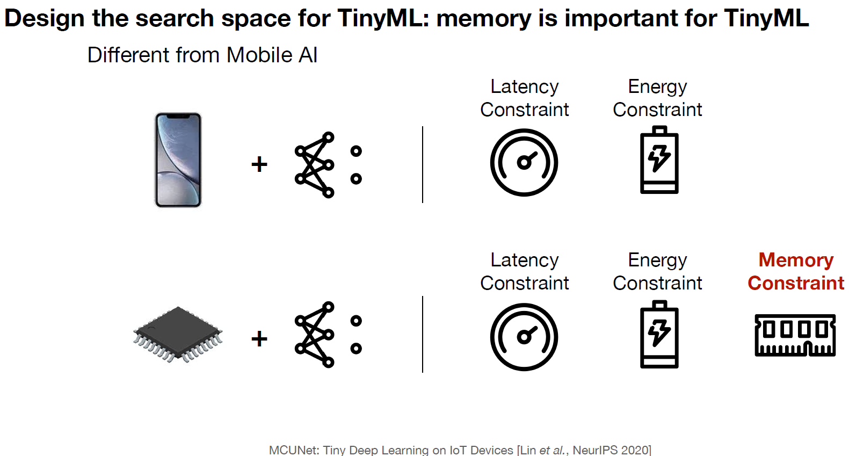
(1/3) Search Space:
Source: MIT 6.5940 - TinyML and Efficient Deep Learning Computing

Slide 23
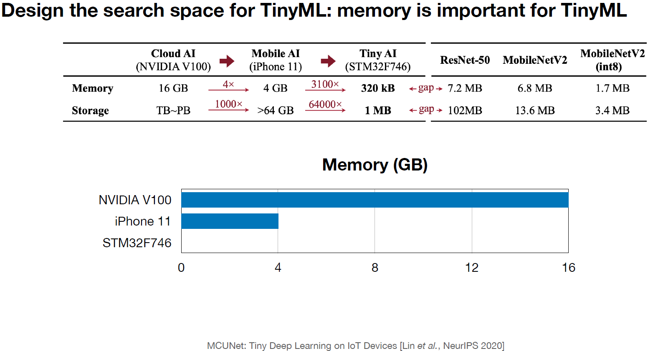
(1/3) Search Space:
Source: MIT 6.5940 - TinyML and Efficient Deep Learning Computing

Slide 24
The 3 Components of NAS (2/3): The Search Strategy
How to explore the search space for a suitable model

Slide 25
(2/3) The Search Strategy
We have our Search Space, which is massive.
How do we find the best architecture without testing everything?
Example Methods:
Grid search
Random search
Reinforcement learning
Gradient descent
Evolutionary search

Slide 26
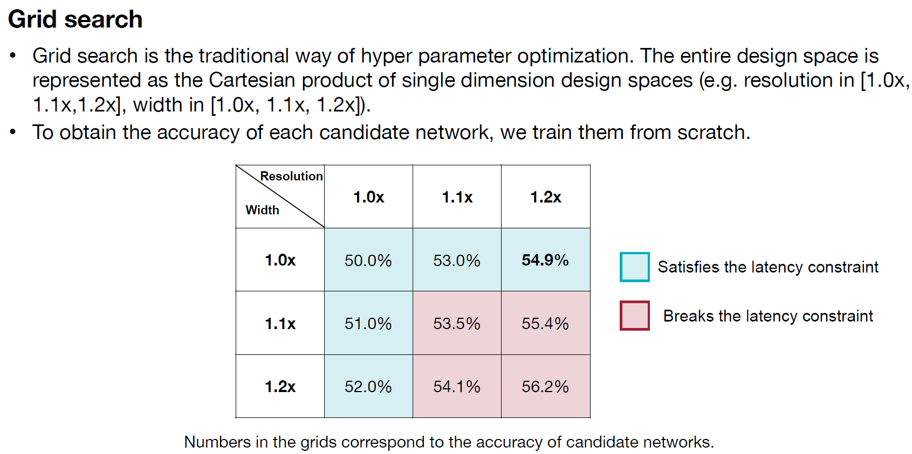
(2/3) The Search Strategy
Source: MIT 6.5940 - TinyML and Efficient Deep Learning Computing

Slide 27
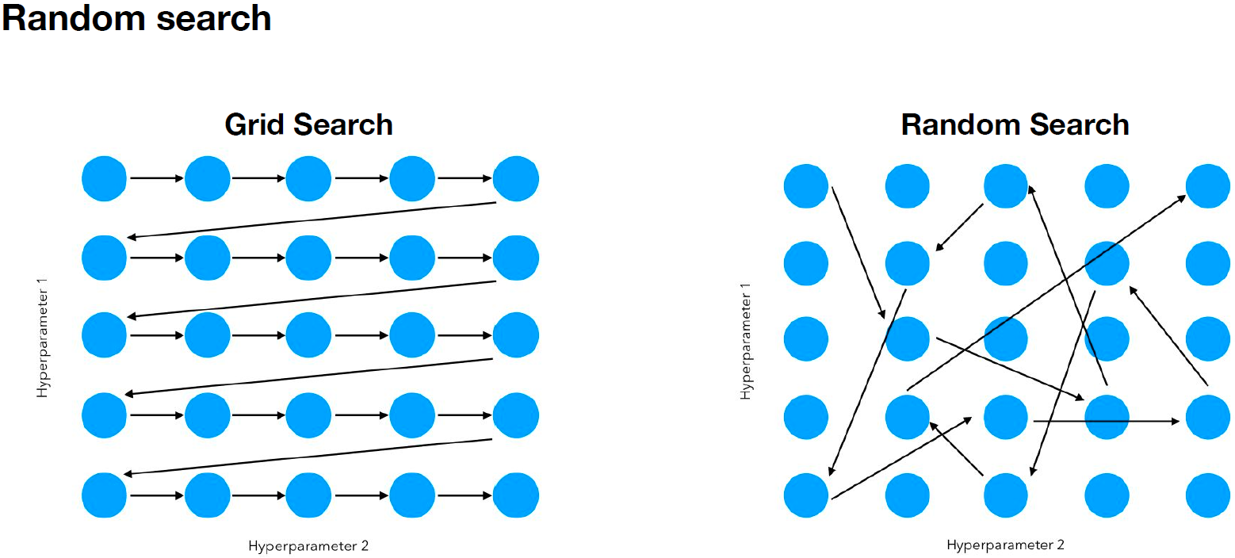
(2/3) The Search Strategy
Source: MIT 6.5940 - TinyML and Efficient Deep Learning Computing

Slide 28
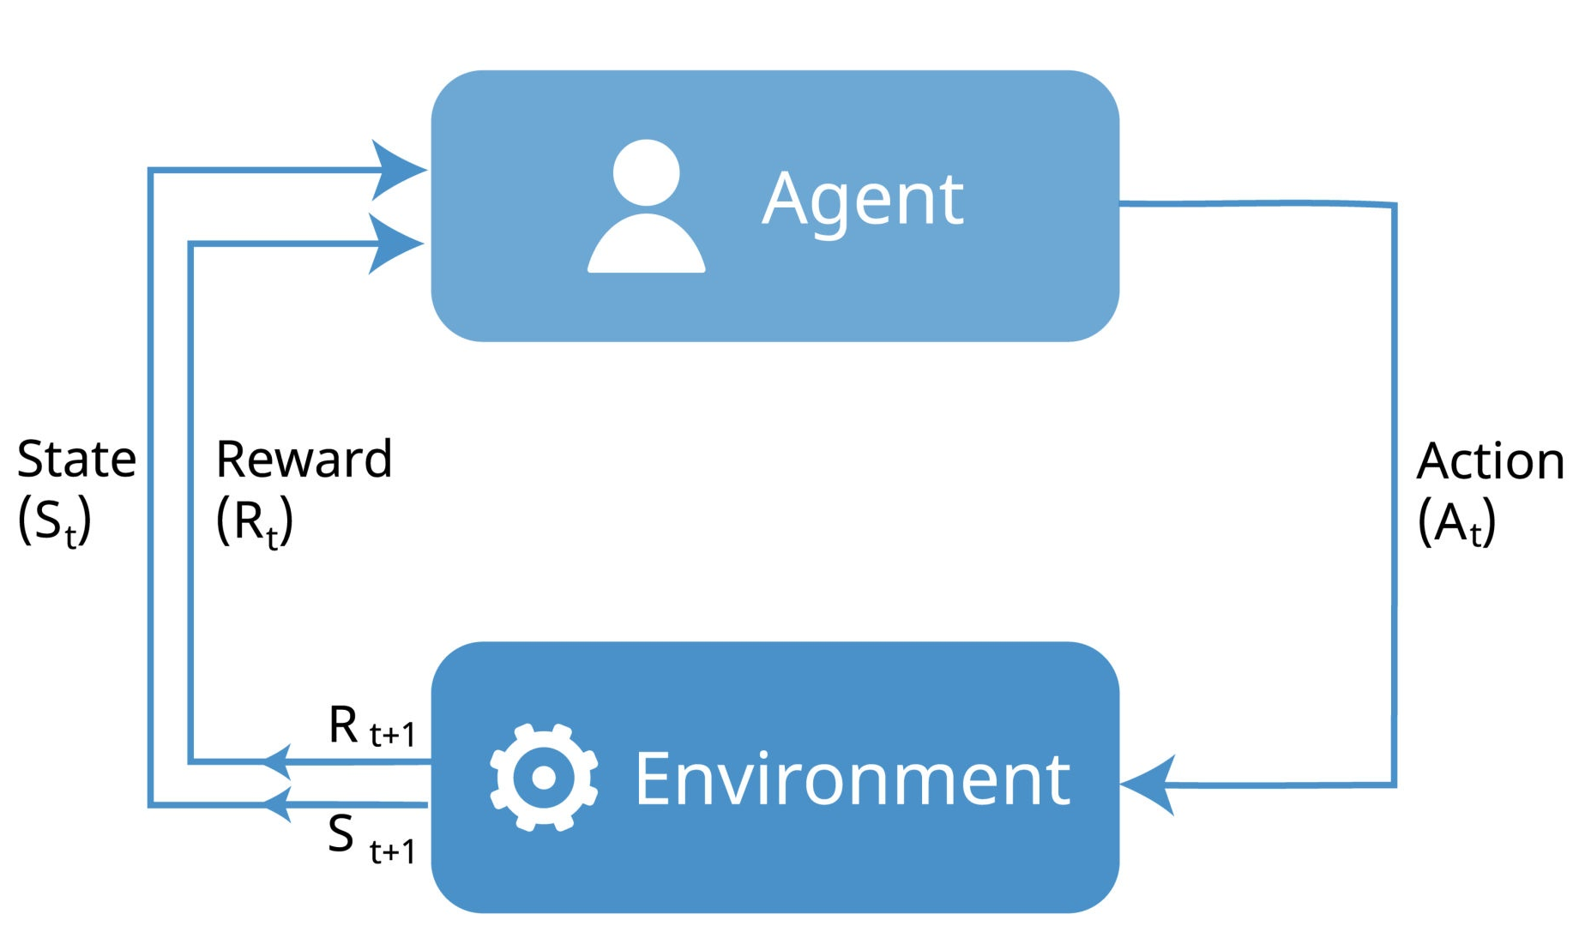
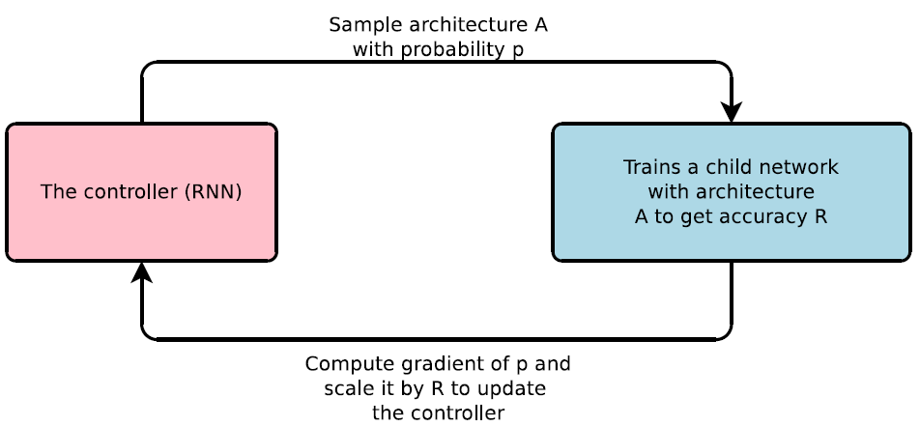
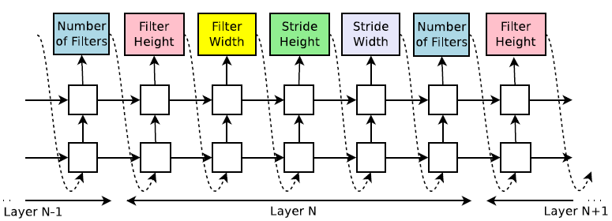
(2/3) The Search Strategy
Reinforcement Learning
Reinforcement Learning
RL-Based NAS
RNN Controller
Zoph, Barret, et al. "Learning transferable architectures for scalable image recognition." Proceedings of the IEEE conference on computer vision and pattern recognition. 2018.
Source: MIT 6.5940 - TinyML and Efficient Deep Learning Computing

Slide 29
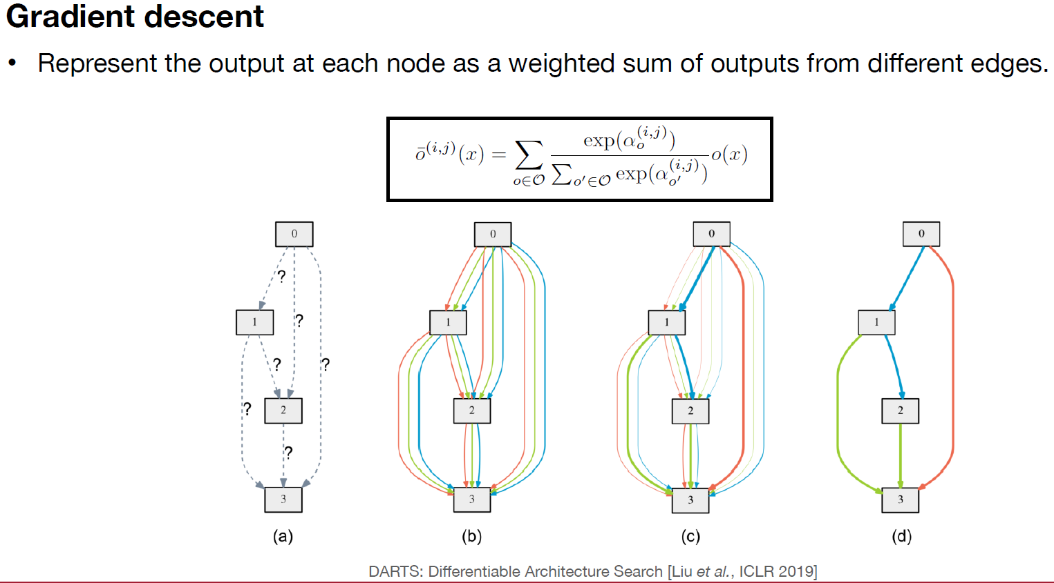
(2/3) The Search Strategy
Source: MIT 6.5940 - TinyML and Efficient Deep Learning Computing

Slide 30
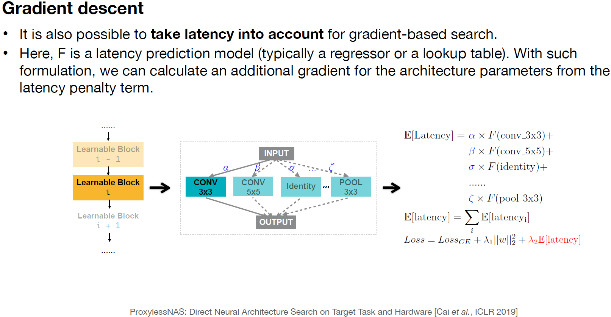
(2/3) The Search Strategy
Source: MIT 6.5940 - TinyML and Efficient Deep Learning Computing

Slide 31
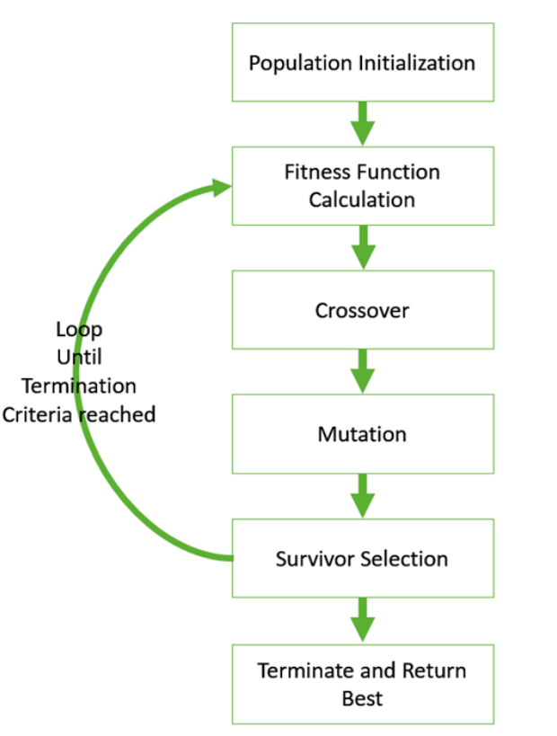
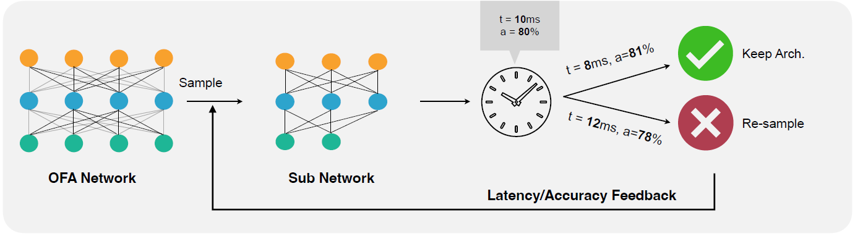
(2/3) The Search Strategy
Evolutionary search: fitness function
Fitness function: F(accuracy, efficiency)
Source: MIT 6.5940 - TinyML and Efficient Deep Learning Computing

Slide 32
The 3 Components of NAS (3/3): Performance Estimation
The 'Judge': How do we score an architecture?
Notes:
Key Question: The search strategy gives us a blueprint. How do we know if it's good? This is the biggest bottleneck in all of NAS.

Slide 33
(3/3) Performance Estimation
Performance Estimation
The Obvious Way: Train from Scratch
For every proposed architecture, train it fully on the dataset (e.g., CIFAR-10) until convergence.
Evaluate its accuracy on a validation set. This accuracy is the "performance estimate" or reward R.
The Drawback: Prohibitive Cost! 💸
The original NAS paper trained ~12,800 models on CIFAR-10.
This took 22,400 GPU-hours (almost 2.5 GPU-years!).
Scaling this to large datasets like ImageNet is often computationally infeasible
Need Faster ways to estimate performance.

Slide 34
(3/3) Performance Estimation
Smarter Approaches:
The Goal: Avoid fully training every single candidate architecture.
Hypernetwork-Based Estimation
Train a "meta-model" called a hypernetwork.
Proxy and Surrogate Models (Weight Sharing / Supernet-Based)
The Once-for-All (OFA) Solution
Graph hypernetworks for neural architecture search C Zhang, M Ren, R Urtasun - arXiv preprint arXiv:1810.05749, 2018
Notes:
A hypernetwork takes an architecture's design and instantly generates its weights.
These weights are used for a single, fast evaluation to estimate performance, skipping full training.

Slide 35
NAS: The Big Picture (Recap)
NAS automates network design using three components:
Search Space: The "menu" of possible layers and connections (e.g., Cell-based, Supernet).
Search Strategy (The Brain): The algorithm to explore the menu (e.g., RL, Evolutionary, Gradient-based).
Performance Estimation (The Judge): The "shortcut" to score an architecture (e.g., Weight-sharing).

Slide 36
NAS: The Once-for-All Solution
Once-for-All: Train One Network and Specialize it for Efficient Deployment
[Cai et al., ICLR 2020]
Notes:
Key Question: The search strategy gives us a blueprint. How do we know if it's good? This is the biggest bottleneck in all of NAS.

Slide 37
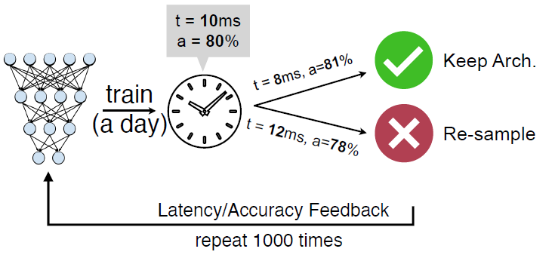
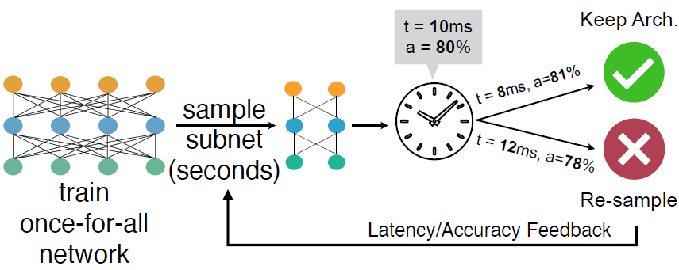
Once-for-All: Train One Network and Specialize It for Deployment
Goal: Efficient Neural Architecture Search for deployment on various devices.
Key Idea: Train one large network and extract many smaller, specialized subnetworks from it.
Once-for-All: Train One Network and Specialize it for Efficient Deployment [Cai et al., ICLR 2020]
Source: MIT 6.5940 - TinyML and Efficient Deep Learning Computing

Slide 38
The Core Idea of Once-for-All (OFA)
Traditional NAS: Train thousands of candidate models — slow and expensive.
OFA: Train one 'supernet' that includes all sub-networks.
Each sub-network inherits weights from the supernet — no retraining needed.
Decouples training from architecture search.
Once-for-All: Train One Network and Specialize it for Efficient Deployment [Cai et al., ICLR 2020]
Source: MIT 6.5940 - TinyML and Efficient Deep Learning Computing

Slide 39
OFA Step 1: Train with Progressive Shrinking
OFA trains the largest model first, then progressively supports smaller networks.
Dimensions:
Depth
Width
Kernel Size
Resolution.
This enables each smaller subnetwork to perform well without retraining.
The current model acts as a “teacher” for knowledge distillation for shrinked models.
Once-for-All: Train One Network and Specialize it for Efficient Deployment [Cai et al., ICLR 2020]
Source: MIT 6.5940 - TinyML and Efficient Deep Learning Computing

Slide 40
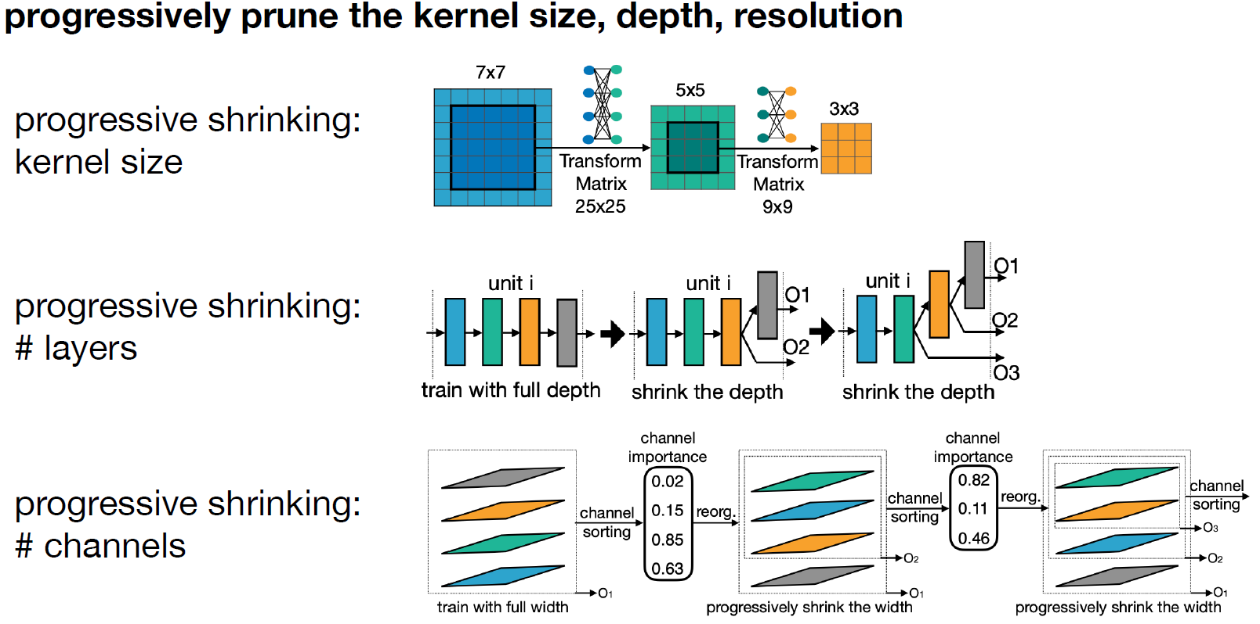
OFA Step 1: Train with Progressive Shrinking
Once-for-All: Train One Network and Specialize it for Efficient Deployment [Cai et al., ICLR 2020]
Source: MIT 6.5940 - TinyML and Efficient Deep Learning Computing

Slide 41
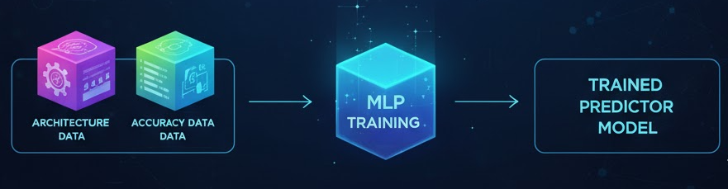
OFA: Step 2 - The Search Phase
The Problem: The trained OFA supernet contains billions of potential sub-networks. How do we find the single best one for our specific hardware?
The Goal: Find the sub-network with the highest accuracy that meets a specific hardware constraint (e.g., Latency < 10ms or Memory < 1MB).
The Solution: We use a MLP Predictor-Based Evolutionary Search.
Collect Architecture-accuracy-latency data and train the MLP over it.
Once-for-All: Train One Network and Specialize it for Efficient Deployment [Cai et al., ICLR 2020]
Source: MIT 6.5940 - TinyML and Efficient Deep Learning Computing

Slide 42
OFA: Step 2 - The Search Phase
MLP Predictor-Based Evolutionary Search.
The Key Advantage: This entire search is extremely fast (seconds to minutes).
We don't need the real hardware for every check. We use a "latency and accuracy predictor" model to estimate the hardware cost, which is much faster.
Once-for-All: Train One Network and Specialize it for Efficient Deployment [Cai et al., ICLR 2020]
Source: MIT 6.5940 - TinyML and Efficient Deep Learning Computing

Slide 43
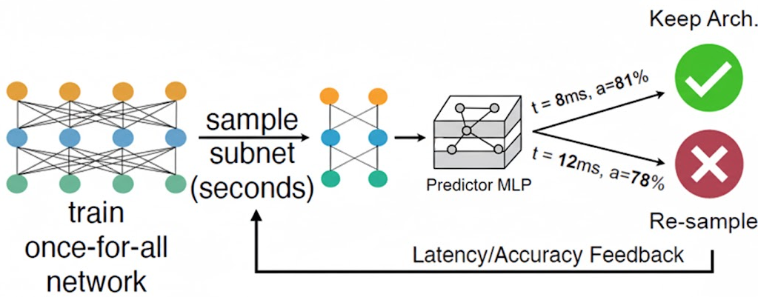
OFA: How Predictor-Based Evolutionary Search Works
We use genetic algorithm to "evolve" the best architecture:
Initialize: Start with a "population" of random subnets sampled from the supernet.
Evaluate Fitness: Each subnet is instantly scored using the predictor MLP which predicts the accuracy as well as the constraint (e.g. latency)
Once-for-All: Train One Network and Specialize it for Efficient Deployment [Cai et al., ICLR 2020]
Source: MIT 6.5940 - TinyML and Efficient Deep Learning Computing

Slide 44
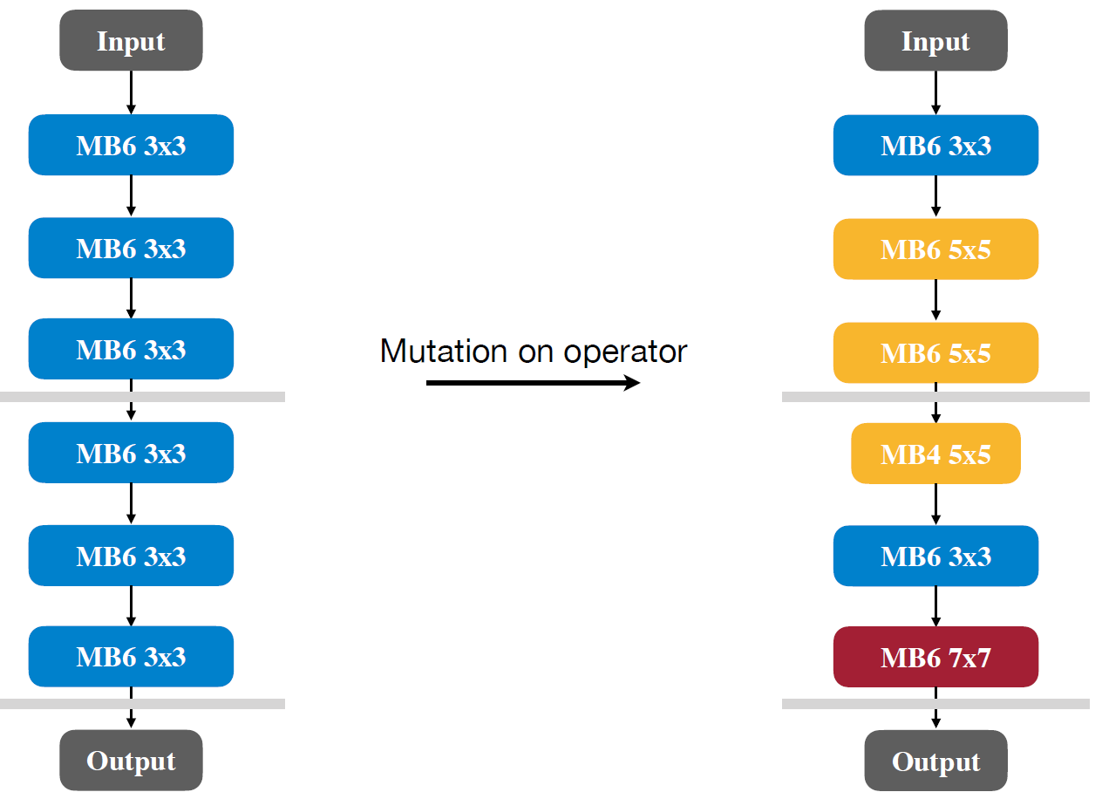
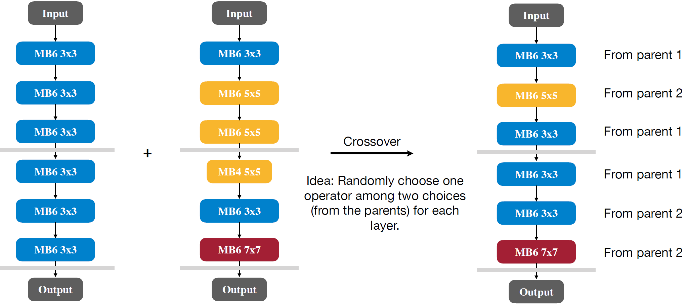
OFA: How Predictor-Based Evolutionary Search Works
Evolve: The "fittest" subnets (high accuracy, predicted low latency) are selected. They create a new, better generation through:
Mutation (small random changes, like kernel size or depth).
Crossover (combining two good "parent" architectures).
Repeat: This process is repeated, and the population quickly "evolves" to find a highly optimized sub-network for the target hardware.
Once-for-All: Train One Network and Specialize it for Efficient Deployment [Cai et al., ICLR 2020]
Source: MIT 6.5940 - TinyML and Efficient Deep Learning Computing

Slide 45
Advantages of OFA
✅ Train once, deploy everywhere.
✅ Much faster specialization for new hardware.
✅ Maintains high accuracy across subnetworks.
✅ Avoids costly retraining for every deployment scenario.
Once-for-All: Train One Network and Specialize it for Efficient Deployment [Cai et al., ICLR 2020]
Source: MIT 6.5940 - TinyML and Efficient Deep Learning Computing

Slide 46
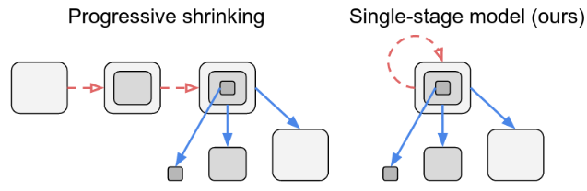
BigNAS: Efficient Supernet Training
Problem in OFA: Uses progressive shrinking:
Training in phases by shrinking the model size – hence slow
Training not “fair” — larger subnets dominate gradient updates, while smaller ones got less attention (gradient bias).
Motivation: Improve fairness and efficiency of supernet training.
Goal: Train all subnetworks fairly and efficiently in one unified stage.
Extends the Once-for-All approach with new training techniques.
Bignas: Scaling up neural architecture search with big single-stage models." European Conference on Computer Vision. [Yu, Jiahui, et al. 2020]

Slide 47
BigNAS: Scaling Up the Once-for-All Idea
BigNAS Solution: Single-Stage Supernet Training
Train the entire supernet in one single stage, without progressive shrinking, and without any external teacher.
In-Place Knowledge Distillation:
During training, the largest subnet acts as the teacher.
Smaller subnets (sampled from the same supernet) act as students.
Both are trained together on the same batch of data in a single iteration.
This makes the smaller subnets learn better representations, without needing an extra pre-trained teacher model.
Bignas: Scaling up neural architecture search with big single-stage models." European Conference on Computer Vision. [Yu, Jiahui, et al. 2020]

Slide 48
Key Techniques in BigNAS
1️⃣ In-Place Knowledge Distillation: Largest subnetwork acts as a teacher for smaller ones.
2️⃣ Sandwich Rule: Train largest, smallest, and random subnetworks in each iteration.
3️⃣ Single-Stage Training: Eliminates the need for progressive shrinking.
Result: Balanced, efficient training for all subnetworks.
Bignas: Scaling up neural architecture search with big single-stage models." European Conference on Computer Vision. [Yu, Jiahui, et al. 2020]

Slide 49
Why BigNAS Matters
Improves ranking consistency between subnetworks and their final models.
Ensures smaller subnetworks are not neglected during training.
More accurate and fair weight-sharing in NAS.
Bignas: Scaling up neural architecture search with big single-stage models." European Conference on Computer Vision. [Yu, Jiahui, et al. 2020]

Slide 50
OFA vs BigNAS Comparison
Aspect | OFA (Once-for-All) | BigNAS
Training Method | Multi-stage progressive shrinking | Single-stage end-to-end training
Knowledge Distillation | Uses an external teacher model | In-place distillation (built-in teacher–student)
Gradient Fairness | Gradients are biased toward large sub-networks | Balanced gradients using the Sandwich Rule
Training Speed | Slower due to multi-phase training | Faster and more scalable
Once-for-All: Train One Network and Specialize it for Efficient Deployment [Cai et al., ICLR 2020]
Bignas: Scaling up neural architecture search with big single-stage models. European Conference on Computer Vision. [Yu, Jiahui, et al. 2020]

Slide 51
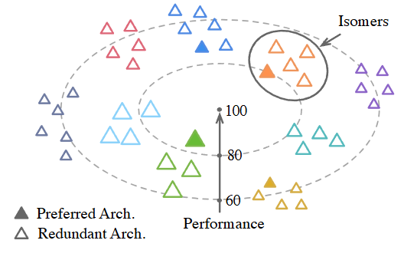
PreNAS: Preferred One-Shot Learning for Efficient NAS
Motivation: One-shot NAS still wastes time on weak subnetworks.
Idea: Pre-select promising subnetworks before training the supernet.
This reduces training cost and search space while improving performance.
H Wang, C Ge, H Chen, X Sun - International conference on machine learning, 2023

Slide 52
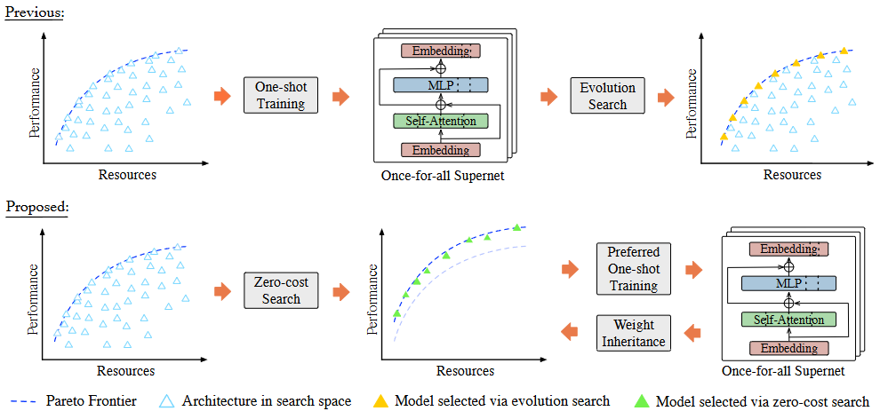
PreNAS Key Contributions
1️⃣ Zero-Cost Selector: Quickly estimate promising subnetworks using lightweight metrics.
2️⃣ Preferred Set Sampling: Focus supernet training only on likely high-performing subnetworks.
3️⃣ Efficient Deployment: Each subnetwork is ready for specialization after shared training.

Slide 53
Impact of PreNAS on NAS and TinyML
Benefit: Significant reduction in search complexity and better utilization of compute.
Eliminates need for retraining thousands of subnetworks.
More hardware-aware model selection for TinyML devices.
PreNAS + OFA = Faster, smarter specialization pipeline.
Represents next evolution toward fully automated NAS.

Slide 54
NAS Evolution Timeline
2017: NASNet — Reinforcement Learning based NAS (cell-based).
2019: DARTS — Differentiable NAS (gradient-based).
2020: OFA — Train once, specialize many (progressive shrinking).
2020: BigNAS — Single-stage, Sandwich Rule, In-Place KD.
2023: PreNAS — Preferred one-shot training for efficiency.
2023: DeepMAD — Mathematical Formulation for Better CNNs
→ Trend: Toward faster, fairer, more adaptive supernet training.

Slide 55
Thank you!

